Slide 1
DESIGN OF A SPREAD-SPECTRUM DATA TRANSMISSION SYSTEM
Master Project 1
Daniel Pedder
Mahalakshmi Krishnan
Thomas Homm

Slide 2
CONTENT
Motivation
Fundamentals of Spread-Spectrum Communications
Design of the System
Implementation in SpinalHDL
Hardware Demonstration
Outlook and Conclusion
Design of a Spread-Spectrum Data Transmission system - Daniel Pedder - Mahalakshmi Krishnan - Thomas Homm
07/14/2026

Slide 3
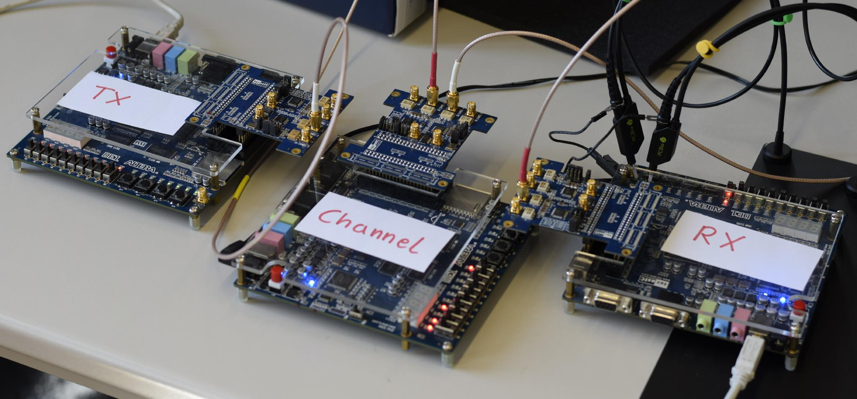
MOTIVATION
Build a spread-spectrum digital communication system entirely in hardware using SpinalHDL, testing whether SpinalHDL's abstractions (loops, generics, case classes) make a complex design more approachable
Three main components: transmitter, noise channel emulator, and receiver
Used as a real test of SpinalHDL on a DSP-heavy design
Design of a Spread-Spectrum Data Transmission system - Daniel Pedder - Mahalakshmi Krishnan - Thomas Homm
07/14/2026

Slide 4
PROJECT GOALS
Build a working DSSS transmitter + receiver on real FPGA hardware
Specifically solve acquisition and tracking under real constraints (50 MHz clock, no floating-point)
Evaluate SpinalHDL as the implementation language.

Slide 5
TAKEAWAYS FROM THIS PROJECT
Why spread signal exists at all: spreading a signal wider doesn't cost transmit power - Shannon-Hartley
What DSSS mechanically is: spreads one data bit into many chips using a LFSR-generated code
Why it's worth the the payoff: wider spread - resistant to narrowband interference, and multiple users can share the same band (CDMA)

Slide 6
KEY LESSONS
Why Spread Spectrum?
What is Spread Spectrum?
Toolchain
Design of the System
Implementation in SpinalHDL
Hardware Demonstration
Outlook and Conclusion
Design of a Spread-Spectrum Data Transmission system - Daniel Pedder - Mahalakshmi Krishnan - Thomas Homm
07/14/2026

Slide 7
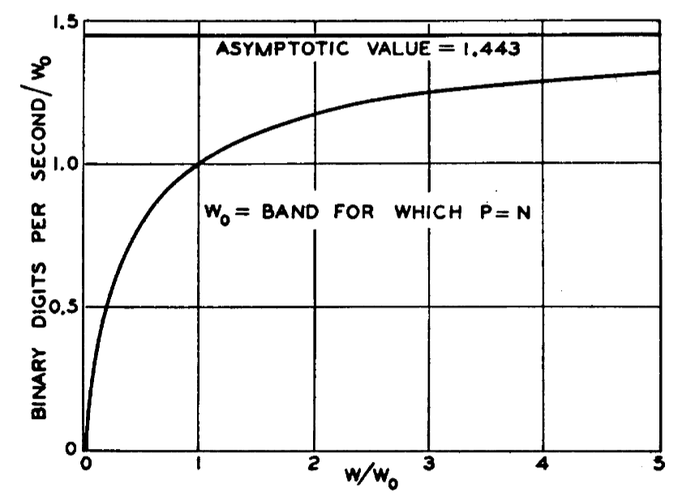
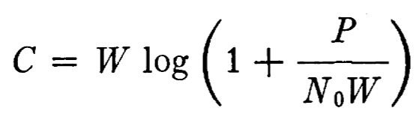
JUSTIFICATION OF SPREAD SPECTRUM COMMUNICATION
C. E. Shannon, "Communication in the Presence of Noise," in Proceedings of the IRE, vol. 37, no. 1, pp. 10-21, Jan. 1949, doi: 10.1109/JRPROC.1949.232969.
Design of a Spread-Spectrum Data Transmission system - Daniel Pedder - Mahalakshmi Krishnan - Thomas Homm
07/14/2026
Notes:
Shannon Hartley Theorem
Channel Capacity
There exists a code so that:
Increased Bandwidth with FIXED TX power
-> arbitrarily close to theoretical maximum bits/second
-> arbitrarily low TX power/Hz
-> arbitrarily insensitive to band limited interference

Slide 8
JUSTIFICATION OF SPREAD SPECTRUM COMMUNICATION
Shannon-Hartley theorem: channel capacity C grows with bandwidth W, even at fixed transmit power P
A signal can be spread across a wider bandwidth without increasing transmit power, even though total noise power increases
With increased bandwidth at fixed TX power, you get arbitrarily close to the theoretical maximum bits/second, arbitrarily low TX power per Hz, arbitrarily insensitive to band-limited interference
This is the theoretical basis DSSS exploits
Design of a Spread-Spectrum Data Transmission system - Daniel Pedder - Mahalakshmi Krishnan - Thomas Homm
07/14/2026
Notes:
Shannon Hartley Theorem
Channel Capacity
There exists a code so that:
Increased Bandwidth with FIXED TX power
-> arbitrarily close to theoretical maximum bits/second
-> arbitrarily low TX power/Hz
-> arbitrarily insensitive to band limited interference

Slide 9
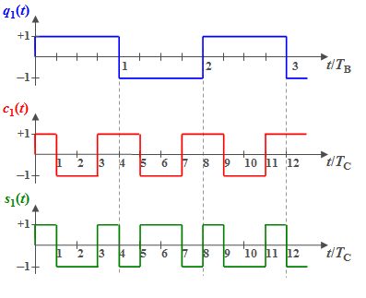
GENERATING A SPREAD SPECTRUM SIGNAL: DSSS
Direct Sequence Spread Spectrum
https://en.lntwww.de/Examples_of_Communication_Systems/Telecommunications_Aspects_of_UMTS
Design of a Spread-Spectrum Data Transmission system - Daniel Pedder - Mahalakshmi Krishnan - Thomas Homm
07/14/2026

Slide 10
GENERATING A SPREAD SPECTRUM SIGNAL: DSSS
Direct Sequence Spread Spectrum
A single data bit b∈{+1,−1}is held constant for one bit period Tb
It's multiplied by a PN chip sequence c[n] running at a much higher rate. It spreads one bit into many chips.
In hardware: implemented as an XOR between the data bit and the LFSR-generated chip (equivalent to ±1 multiplication)
PN sequence generated by a Linear Feedback Shift Register (LFSR), based on a fixed polynomial
Receiver needs the same polynomial to despread and recover the data, without it just sees noise
1023 chips per data bit, from a 10-bit LFSR
https://en.lntwww.de/Examples_of_Communication_Systems/Telecommunications_Aspects_of_UMTS
Design of a Spread-Spectrum Data Transmission system - Daniel Pedder - Mahalakshmi Krishnan - Thomas Homm
07/14/2026

Slide 11
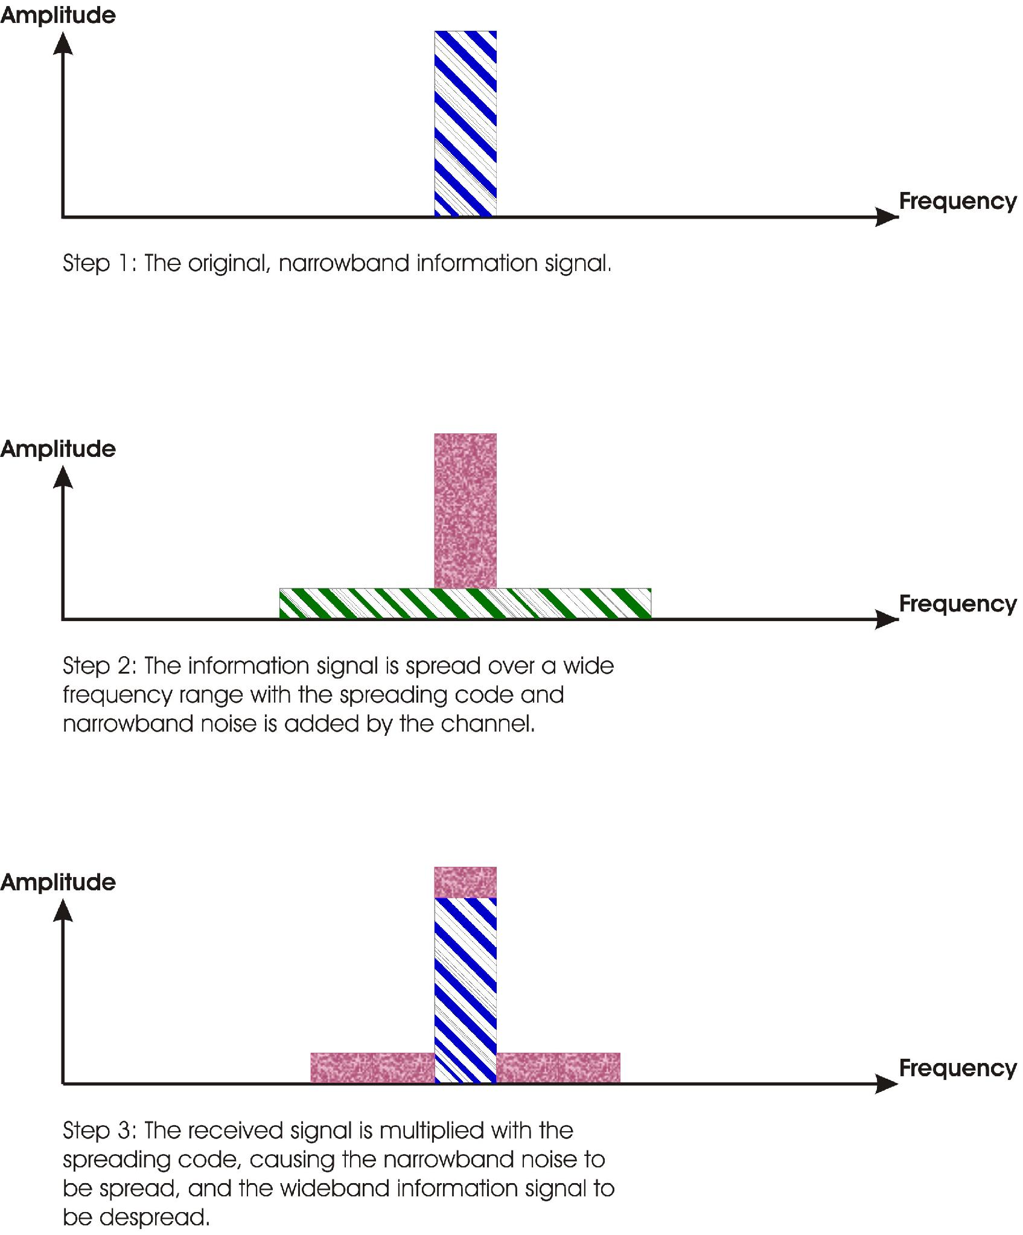
DIRECT SEQUENCE SPREAD SPECTRUM
https://en.lntwww.de/Examples_of_Communication_Systems/Telecommunications_Aspects_of_UMTS
https://commons.wikimedia.org/wiki/File:Processinggain.jpg
Design of a Spread-Spectrum Data Transmission system - Daniel Pedder - Mahalakshmi Krishnan - Thomas Homm
07/14/2026

Slide 12
ANTI-JAMMING COMMUNICATION - DSSS
Direct Sequence Spread Spectrum
Spreading pushes the signal across a wide frequency band, resistant to narrow-band interference and background noise
To meaningfully degrade the signal, an interference source would need to inject power across the entire spread bandwidth, not just a narrow slice
This resilience is quantified by the processing gain: G=Ws/W
Despreading at the receiver reverses the effect: narrowband noise/interference gets spread out, while the wanted signal is coherently reconstructed
Because different users' codes have low cross-correlation, multiple DSSS transmissions can share the same band simultaneously (CDMA) each receiver's correlator suppresses the others as pseudo-noise
if an interferer power is much larger than the desired signal's, residual cross-correlation can still swamp the peak
Design of a Spread-Spectrum Data Transmission system - Daniel Pedder - Mahalakshmi Krishnan - Thomas Homm
07/14/2026

Slide 13
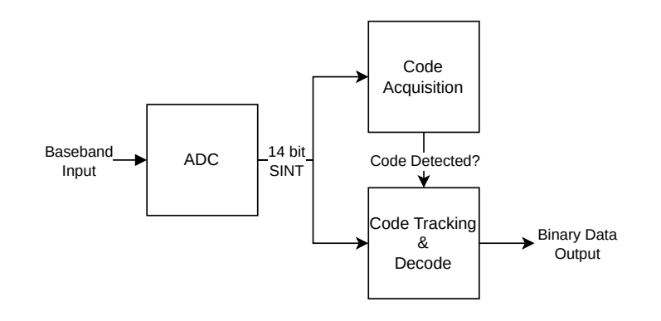
SYSTEM DESIGN - RECEIVER
Design of a Spread-Spectrum Data Transmission system - Daniel Pedder - Mahalakshmi Krishnan - Thomas Homm
07/14/2026
Notes:
Shannon Hartley Theorem
Channel Capacity
There exists a code so that:
Increased Bandwidth with FIXED TX power
-> arbitrarily close to theoretical maximum bits/second
-> arbitrarily low TX power/Hz
-> arbitrarily insensitive to band limited interference

Slide 14
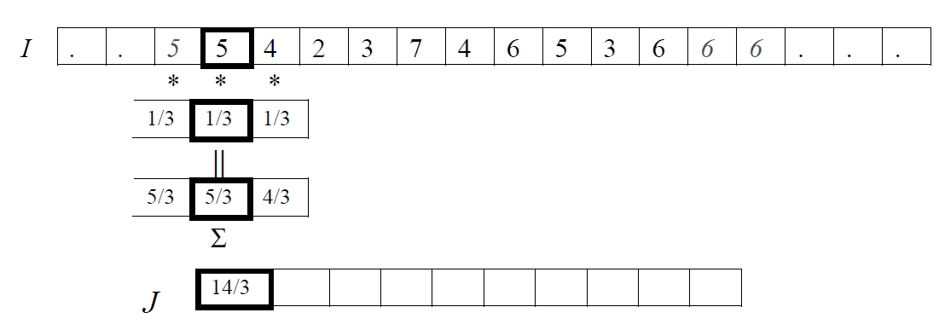
CROSS CORRELATION
https://towardsdatascience.com/convolution-vs-correlation-af868b6b4fb5/
Design of a Spread-Spectrum Data Transmission system - Daniel Pedder - Mahalakshmi Krishnan - Thomas Homm
07/14/2026

Slide 15
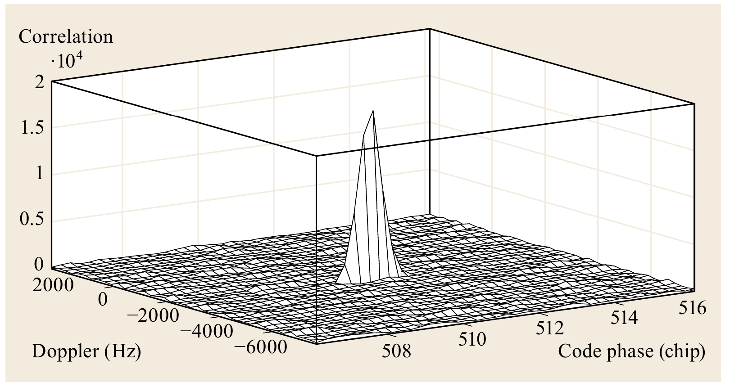
CODE ACQUISITION
T. Pany and J.-H. Won, “Springer Handbook of Global Navigation Satellite Systems - Signal Processing,” 2017, pp. 401–440. doi: 10.1007/978-3-319-42928-1_14.
Design of a Spread-Spectrum Data Transmission system - Daniel Pedder - Mahalakshmi Krishnan - Thomas Homm
07/14/2026

Slide 16
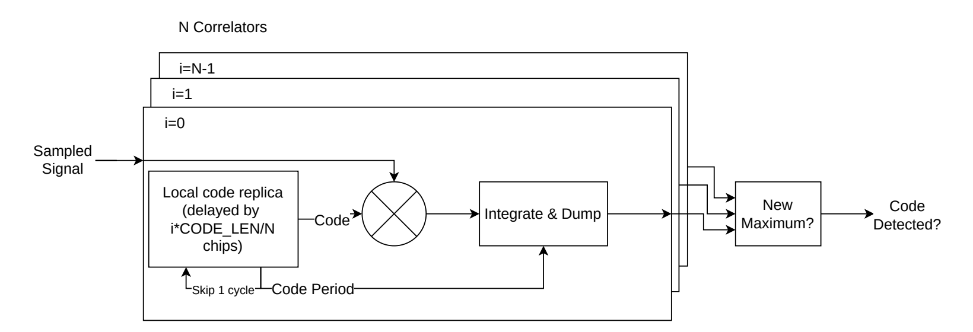
CODE ACQUISITION
Design of a Spread-Spectrum Data Transmission system - Daniel Pedder - Mahalakshmi Krishnan - Thomas Homm
07/14/2026
Notes:
Shannon Hartley Theorem
Channel Capacity
There exists a code so that:
Increased Bandwidth with FIXED TX power
-> arbitrarily close to theoretical maximum bits/second
-> arbitrarily low TX power/Hz
-> arbitrarily insensitive to band limited interference

Slide 17
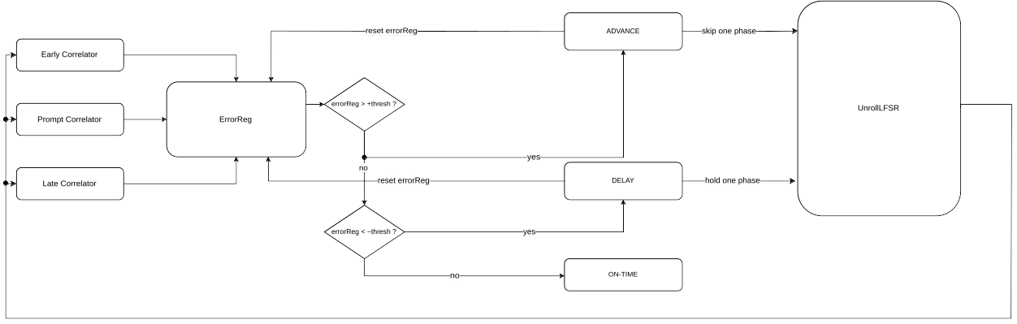
CODE TRACKING
Design of a Spread-Spectrum Data Transmission system - Daniel Pedder - Mahalakshmi Krishnan - Thomas Homm
07/14/2026
Notes:
Shannon Hartley Theorem
Channel Capacity
There exists a code so that:
Increased Bandwidth with FIXED TX power
-> arbitrarily close to theoretical maximum bits/second
-> arbitrarily low TX power/Hz
-> arbitrarily insensitive to band limited interference

Slide 18
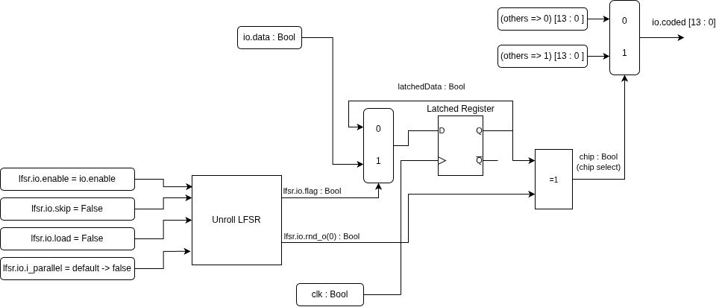
SYSTEM DESIGN - TRANSMITTER
Design of a Spread-Spectrum Data Transmission system - Daniel Pedder - Mahalakshmi Krishnan - Thomas Homm
07/14/2026
Notes:
Shannon Hartley Theorem
Channel Capacity
There exists a code so that:
Increased Bandwidth with FIXED TX power
-> arbitrarily close to theoretical maximum bits/second
-> arbitrarily low TX power/Hz
-> arbitrarily insensitive to band limited interference

Slide 19
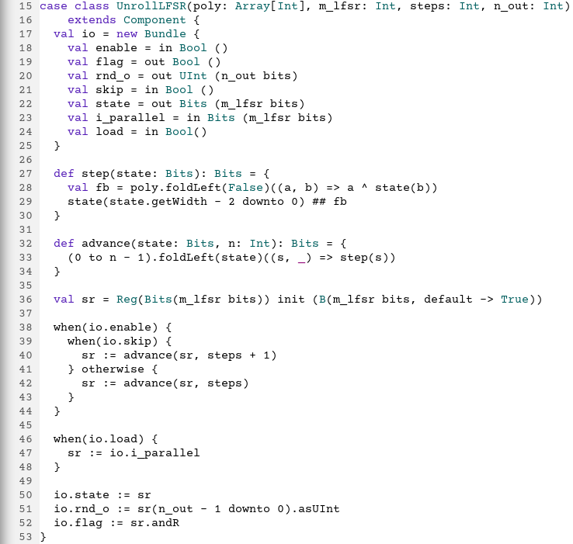
IMPLEMENTATION IN SPINALHDL – WHY SPINALHDL?
Hardware described in the Scala Progamming Language
Components are classes, syntax more aligned to regular programming languages.
All the known programming syntax benefits, like loops, generics, collections, classes and parametrization
Compiles into VHDL/Verilog
Elaboration also happens at compile time, errors are shown before synthesis.
Then, Quartus can be used to deploy code on FPGA
Design of a Spread-Spectrum Data Transmission system - Daniel Pedder - Mahalakshmi Krishnan - Thomas Homm
07/14/2026
Notes:
Shannon Hartley Theorem
Channel Capacity
There exists a code so that:
Increased Bandwidth with FIXED TX power
-> arbitrarily close to theoretical maximum bits/second
-> arbitrarily low TX power/Hz
-> arbitrarily insensitive to band limited interference

Slide 20
IMPLEMENTATION IN SPINALHDL – WHY SPINALHDL?
Design of a Spread-Spectrum Data Transmission system - Daniel Pedder - Mahalakshmi Krishnan - Thomas Homm
07/14/2026
Notes:
Shannon Hartley Theorem
Channel Capacity
There exists a code so that:
Increased Bandwidth with FIXED TX power
-> arbitrarily close to theoretical maximum bits/second
-> arbitrarily low TX power/Hz
-> arbitrarily insensitive to band limited interference

Slide 21
CHALLENGES
Slow Design Iteration
Slow Simulation
Design of a Spread-Spectrum Data Transmission system - Daniel Pedder - Mahalakshmi Krishnan - Thomas Homm
07/14/2026
Notes:
Shannon Hartley Theorem
Channel Capacity
There exists a code so that:
Increased Bandwidth with FIXED TX power
-> arbitrarily close to theoretical maximum bits/second
-> arbitrarily low TX power/Hz
-> arbitrarily insensitive to band limited interference

Slide 22
IMPLEMENTATION IN SPINALHDL – WHY SPINALHDL?
Design of a Spread-Spectrum Data Transmission system - Daniel Pedder - Mahalakshmi Krishnan - Thomas Homm
07/14/2026
Notes:
Shannon Hartley Theorem
Channel Capacity
There exists a code so that:
Increased Bandwidth with FIXED TX power
-> arbitrarily close to theoretical maximum bits/second
-> arbitrarily low TX power/Hz
-> arbitrarily insensitive to band limited interference

Slide 23
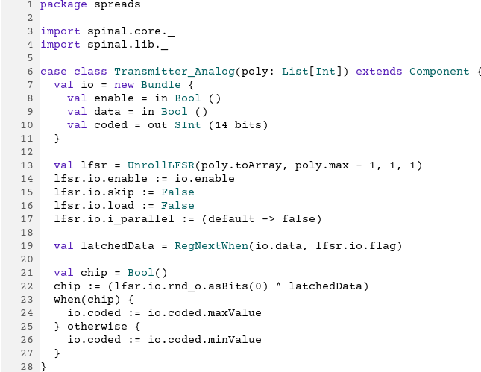
IMPLEMENTATION IN SPINALHDL – EXAMPLE CODE: TRANSMITTER
Design of a Spread-Spectrum Data Transmission system - Daniel Pedder - Mahalakshmi Krishnan - Thomas Homm
07/14/2026
Notes:
Shannon Hartley Theorem
Channel Capacity
There exists a code so that:
Increased Bandwidth with FIXED TX power
-> arbitrarily close to theoretical maximum bits/second
-> arbitrarily low TX power/Hz
-> arbitrarily insensitive to band limited interference

Slide 24
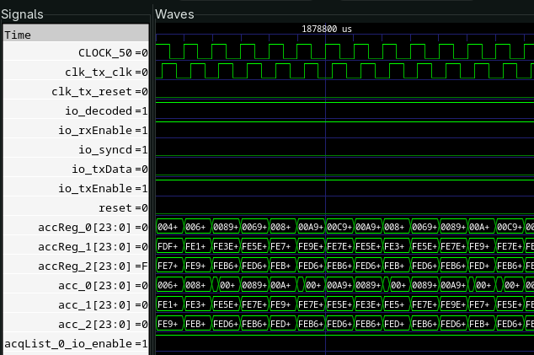
IMPLEMENTATION IN SPINALHDL – VERIFICATION IN SPINALHDL
The whole simulation is written in SpinalHDL
No separate VHDL/SystemVerilog testbench
Verilator compiles the generated Verilog into C++ simulator code, which SpinalHDL drives via the testbench.
A Value Change Dump (VCD) stores every signals value change over simulated time, which tools like GTKWave load to visually inspect the simulation.
GTK Wave then gives us a proper simulation waveform, like seen in the example image
Design of a Spread-Spectrum Data Transmission system - Daniel Pedder - Mahalakshmi Krishnan - Thomas Homm
07/14/2026
Notes:
Shannon Hartley Theorem
Channel Capacity
There exists a code so that:
Increased Bandwidth with FIXED TX power
-> arbitrarily close to theoretical maximum bits/second
-> arbitrarily low TX power/Hz
-> arbitrarily insensitive to band limited interference

Slide 25
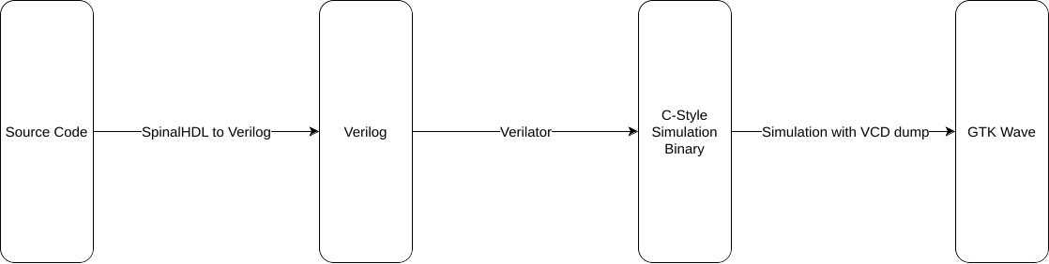
IMPLEMENTATION IN SPINALHDL – SIMULATION FLOW OVERVIEW
Design of a Spread-Spectrum Data Transmission system - Daniel Pedder - Mahalakshmi Krishnan - Thomas Homm
07/14/2026
Notes:
Shannon Hartley Theorem
Channel Capacity
There exists a code so that:
Increased Bandwidth with FIXED TX power
-> arbitrarily close to theoretical maximum bits/second
-> arbitrarily low TX power/Hz
-> arbitrarily insensitive to band limited interference

Slide 26
HARDWARE DEMONSTRATION – SETUP EXPLANATION
3 FPGA Boards used
Transmitter → Channel (adds noise) → Receiver
The output is seen as a LED on the Receiver
Amount of noise controllable via switches
Design of a Spread-Spectrum Data Transmission system - Daniel Pedder - Mahalakshmi Krishnan - Thomas Homm
07/14/2026
Notes:
Shannon Hartley Theorem
Channel Capacity
There exists a code so that:
Increased Bandwidth with FIXED TX power
-> arbitrarily close to theoretical maximum bits/second
-> arbitrarily low TX power/Hz
-> arbitrarily insensitive to band limited interference

Slide 27
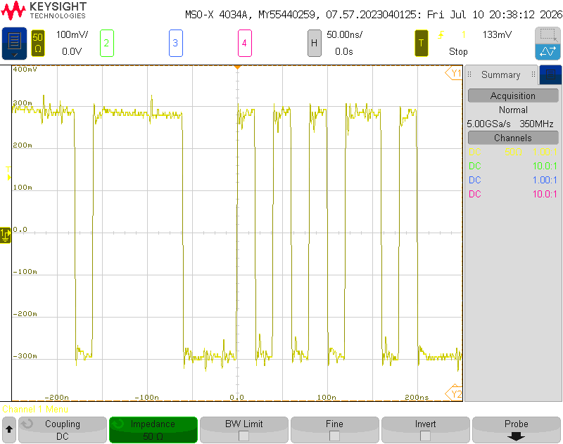
HARDWARE DEMONSTRATION – TX SIGNAL
Design of a Spread-Spectrum Data Transmission system - Daniel Pedder - Mahalakshmi Krishnan - Thomas Homm
07/14/2026
Notes:
Shannon Hartley Theorem
Channel Capacity
There exists a code so that:
Increased Bandwidth with FIXED TX power
-> arbitrarily close to theoretical maximum bits/second
-> arbitrarily low TX power/Hz
-> arbitrarily insensitive to band limited interference

Slide 28
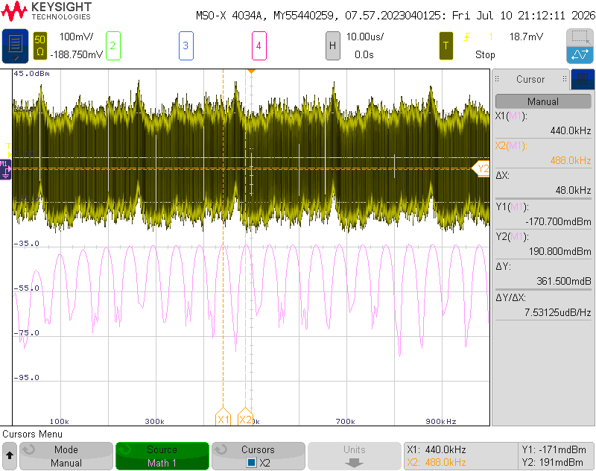
HARDWARE DEMONSTRATION – FFT OF TX SIGNAL
Design of a Spread-Spectrum Data Transmission system - Daniel Pedder - Mahalakshmi Krishnan - Thomas Homm
07/14/2026
Notes:
Shannon Hartley Theorem
Channel Capacity
There exists a code so that:
Increased Bandwidth with FIXED TX power
-> arbitrarily close to theoretical maximum bits/second
-> arbitrarily low TX power/Hz
-> arbitrarily insensitive to band limited interference

Slide 29
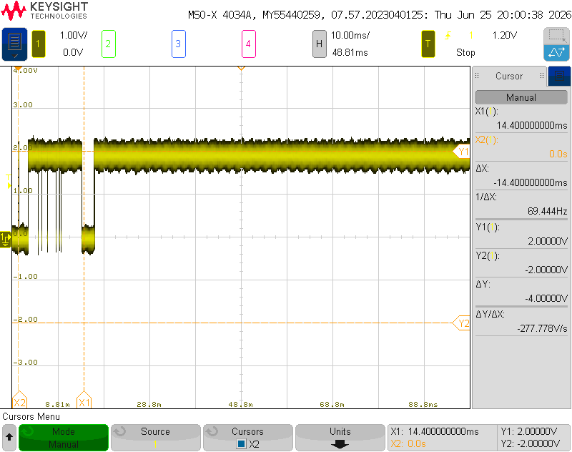
HARDWARE DEMONSTRATION – CODE ACQUISITION
Design of a Spread-Spectrum Data Transmission system - Daniel Pedder - Mahalakshmi Krishnan - Thomas Homm
07/14/2026
Notes:
Shannon Hartley Theorem
Channel Capacity
There exists a code so that:
Increased Bandwidth with FIXED TX power
-> arbitrarily close to theoretical maximum bits/second
-> arbitrarily low TX power/Hz
-> arbitrarily insensitive to band limited interference

Slide 30
OUTLOOK & CONCLUSION
Design of a Spread-Spectrum Data Transmission system - Daniel Pedder - Mahalakshmi Krishnan - Thomas Homm
07/14/2026
Notes:
Shannon Hartley Theorem
Channel Capacity
There exists a code so that:
Increased Bandwidth with FIXED TX power
-> arbitrarily close to theoretical maximum bits/second
-> arbitrarily low TX power/Hz
-> arbitrarily insensitive to band limited interference

Slide 31
Thank you for your Attention!
Notes:
1. Which other drone jamming techniques could you imagine?
2. How do modern communication techniques prevent themselves fRom Jamming and interference?
3. why is simultaneous sending and receiving generally a problem in radio communication?
4. How else could you protect a UAV from jamming

Slide 32
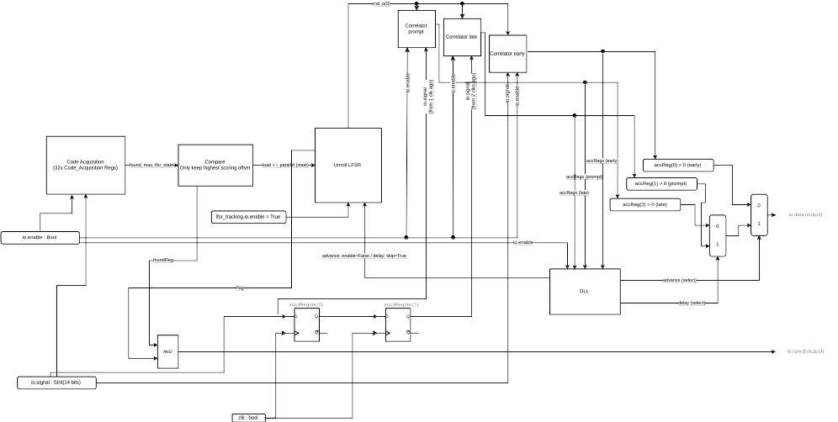
SYSTEM DESIGN - RECEIVER
Design of a Spread-Spectrum Data Transmission system - Daniel Pedder - Mahalakshmi Krishnan - Thomas Homm
07/14/2026
Notes:
Shannon Hartley Theorem
Channel Capacity
There exists a code so that:
Increased Bandwidth with FIXED TX power
-> arbitrarily close to theoretical maximum bits/second
-> arbitrarily low TX power/Hz
-> arbitrarily insensitive to band limited interference

